Slide 1
Session #2-3:
Multi-armed Bandits
Notes:
Welcome to the course !!!
The idea that we learn by interacting with our environment is probably the first to occur to us when we think about the nature of learning. When an infant plays, waves its arms, or looks about, it has no explicit teacher, but it does have a direct sensorimotor connection to its environment.
Whether we are learning to drive a car or to hold a conversation, we are acutely aware of how our environment responds to what we do, and we seek to influence what happens through our behavior.
Learning from interaction is a foundational idea underlying nearly all theories of learning and intelligence. We will take a computational approach to learning from interaction.
The specific approach which we use to learn from the environment, which we call as reinforcement learning, is much more focused on goal-directed learning from interaction than are other approaches to machine learning.
In this course, we will look into various kind of experimental setups modelling the agent-environment interaction towards performing goal oriented learning. We will start with very basics, and an elementary model.
This course is a core course for all of you. This course will be taught by myself and Dr. Sangeetha Viswanathan.

Slide 2
Agenda for the class
Recap
k-armed Bandit Problem & its significance
Action-Value Methods
Sample Average Method & Incremental Implementation
Non-stationary Problem
Initial Values & Action Selection

Slide 3
K-armed Bandit Problem
Problem
You are faced repeatedly with a choice among k different options, or actions
After each choice of actions you receive a numerical reward
Reward is chosen from a stationary probability distribution that depends on the selected action
Objective : to maximize the expected total reward over some time period
Notes:
Model the decision making in uncertainty

Slide 4
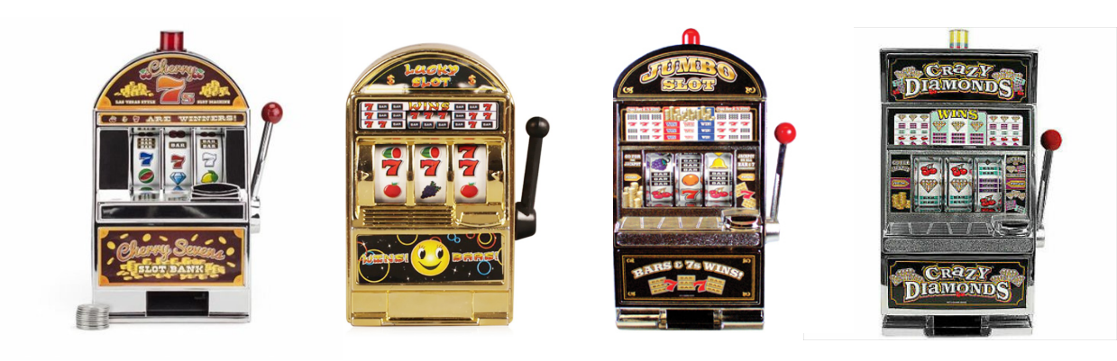
K-armed Bandit Problem
Problem
You are faced repeatedly with a choice among k different options, or actions
After each choice of actions you receive a numerical reward
Reward is chosen from a stationary probability distribution that depends on the selected action
Objective : to maximize the expected total reward over some time period

Slide 5
K-armed Bandit Problem
Problem
You are faced repeatedly with a choice among k different options, or actions
After each choice of actions you receive a numerical reward
Reward is chosen from a stationary probability distribution that depends on the selected action
Objective : to maximize the expected total reward over some time period
Strategy:
Identify the best lever(s)
Keep pulling the identified ones
Questions:
How do we define the best ones?
What are the best levers?

Slide 6
K-armed Bandit Problem
Problem
You are faced repeatedly with a choice among k different options, or actions
After each choice of actions you receive a numerical reward
Reward is chosen from a stationary probability distribution that depends on the selected action
Objective : to maximize the expected total reward over some time period
Strategy:
Identify the best lever(s)
Keep pulling the identified ones
Questions:
How do we define the best ones?
What are the best levers?

Slide 7
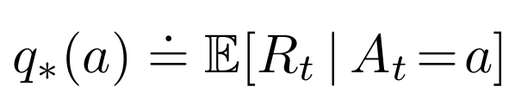
K-armed Bandit Problem
Problem
You are faced repeatedly with a choice among k different options, or actions
After each choice of actions you receive a numerical reward
Reward is chosen from a stationary probability distribution that depends on the selected action
Objective : to maximize the expected total reward over some time period
Expected Mean Reward for each action selected
→ call it Value of the action

Slide 8
K-armed Bandit Problem
A_{t} - action selected on time step t
Q_{t} (a) - estimated value of action a at time step t
q*(a) - value of an arbitrary action a
Note: If you knew the value of each action, then it would be trivial to solve the k -armed bandit problem: you would always select the action with highest value :-)

Slide 9
K-armed Bandit Problem

Slide 10
K-armed Bandit Problem
Keep pulling the levers; update the estimate of action values;

Slide 11
K-armed Bandit Problem

Slide 12
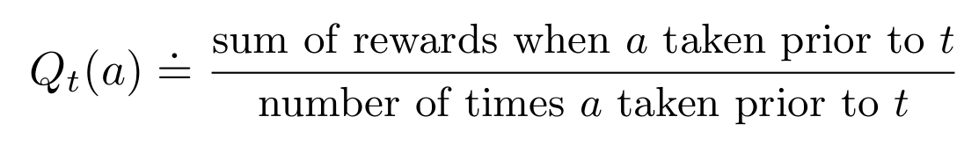
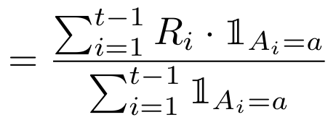
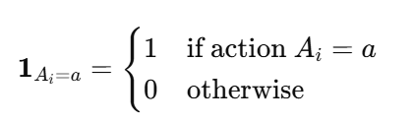
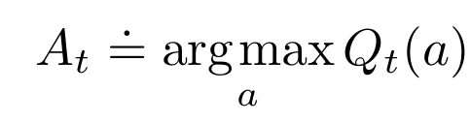
K-armed Bandit Problem
How to maintain the estimate of expected rewards for each action?
Average the rewards actually received !!!
How to use the estimate in selecting the right action?
Greedy Action Selection
Notes:
An indicator function that is 1 if action Ai​ equals action a

Slide 13
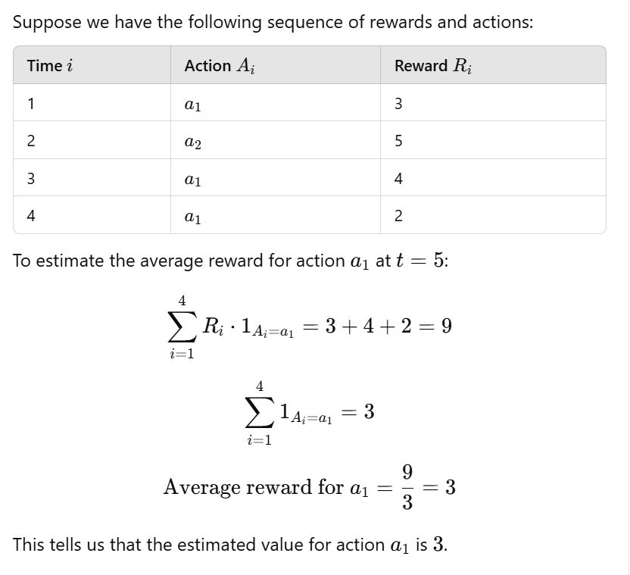
K-armed Bandit Problem
How to maintain the estimate of expected rewards for each action?
Average the rewards actually received !!!
How to use the estimate in selecting the right action?
Greedy Action Selection

Slide 14
K-armed Bandit Problem
2. How to use the estimate in selecting the right action?
Greedy Action Selection
3. Exploration vs. Exploitation?
ε-Greedy Action Selection / near-greedy action selection
Behave greedily most of the time; Once in a while, with small probability 𝛆 select randomly from among all the actions with equal probability, independently of the action-value estimates.
Actions which are inferior by the value estimate upto time t, could be indeed better than the greedy action at t !!!

Slide 15
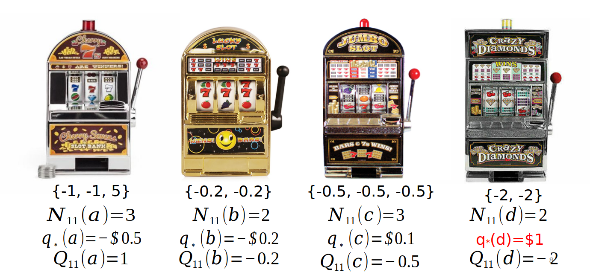
K-armed Bandit Problem
Rewards received
Number of times action was chosen from time step 1 to t (11)
True expected reward
Estimated Value

Slide 16
K-armed Bandit Problem
Greedy Action

Slide 17
K-armed Bandit Problem
Action to Explore

Slide 18
K-armed Bandit Problem
ε-Greedy Action Selection / near-greedy action selection
epsilon = 0.05 // small value to control exploration
def get_action():
if random.random() > epsilon:
return argmaxa(Q(a))
else:
return random.choice(A)
# exploitation
# exploration
In the limit as the number of steps increases, every action will be sampled by ε-greedy action selection an infinite number of times. This ensures that all the Qt (a) converge to q* (a).
Easy to implement / optimize for epsilon / yields good results

Slide 19
Ex-1: In ε-greedy action selection, for the case of two actions and ε = 0.5, what is the probability that the greedy action is selected?
Notes:
Refer to https://ai.stackexchange.com/questions/27931/what-is-the-probability-of-selecting-the-greedy-action-in-a-0-5-greedy-selection
for a good discussion on the solution.

Slide 20
Ex-1: In ε-greedy action selection, for the case of two actions and ε = 0.5, what is the probability that the greedy action is selected?
The Total probability,
p (greedy action)
= p (greedy action AND greedy selection ) + p (greedy action AND random selection )
= p (greedy action | greedy selection ) p ( greedy selection )
+ p (greedy action | random selection ) p (random selection )
= p (greedy action | greedy selection ) (1-𝛆) + p (greedy action | random selection ) (𝛆)
= p (greedy action | greedy selection ) (0.5) + p (greedy action | random selection ) (0.5)
= (1) (0.5) + (0.5) (0.5)
= 0.5 + 0.25
= 0.75
(Using conditional probability formula)
Notes:
Refer to https://ai.stackexchange.com/questions/27931/what-is-the-probability-of-selecting-the-greedy-action-in-a-0-5-greedy-selection
for a good discussion on the solution.

Slide 21
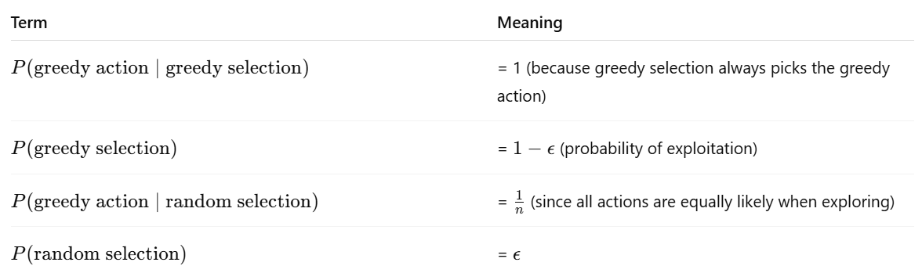
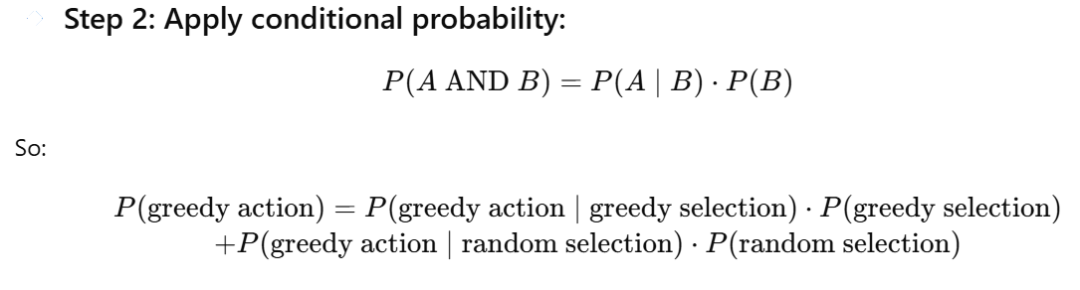
Ex-1: In ε-greedy action selection, for the case of two actions and ε = 0.5, what is the probability that the greedy action is selected?
The Total probability,
p (greedy action)
(You chose the greedy action on purpose)
(You chose the greedy action by luck during random selection)
= p (greedy action | greedy selection ) (1-𝛆) + p (greedy action | random selection ) (𝛆)
= p (greedy action | greedy selection ) (0.5) + p (greedy action | random selection ) (0.5)
= (1) (0.5) + (0.5) (0.5)
= 0.5 + 0.25
= 0.75
Notes:
Refer to https://ai.stackexchange.com/questions/27931/what-is-the-probability-of-selecting-the-greedy-action-in-a-0-5-greedy-selection
for a good discussion on the solution.

Slide 22
Imagine you are a skilled gambler competing in the World Slot Machine Championship, where you must visit 2000 different casinos.
Each casino has 10 mysterious slot machines, each with unknown payout rates.
At every stop, you are given 1000 lever pulls to use however you choose — testing machines, identifying which ones are generous, and maximizing your total reward.
Each casino is completely different, so what works in one may not work in another. Your challenge is to learn and adapt through a mix of exploration and exploitation, using smart strategies to earn the highest possible reward across all

Slide 23
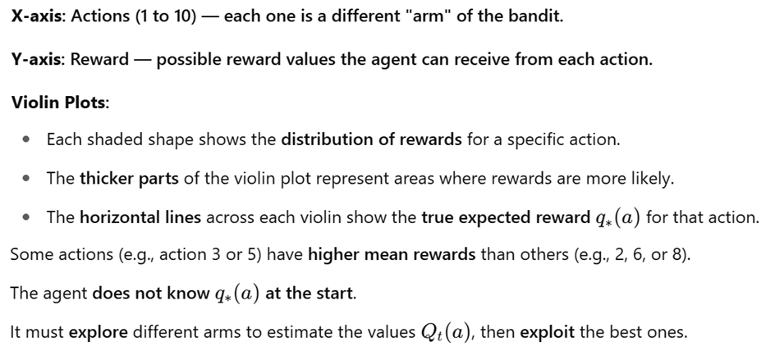
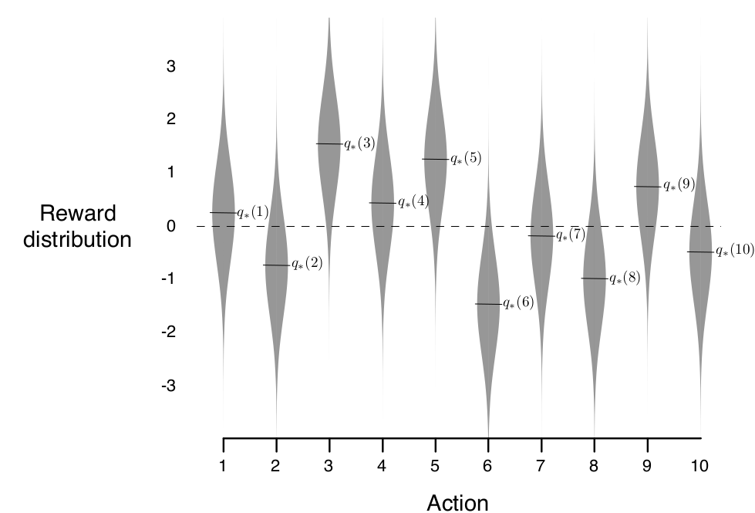
10-armed Testbed
Example:
A set of 2000 randomly generated k -armed bandit problems with k = 10
Action values were selected according to a normal (Gaussian) distribution with mean 0 and variance 1.
While selecting action A_{t} at time step t, the actual reward, R_{t} , was selected from a normal distribution with mean q*(At ) and variance 1
One Run : Apply a method for 1000 time steps to one of the bandit problems
Perform 2000 runs, each run with a different bandit problem, to get an algorithms average behavior
An example bandit problem from the 10-armed testbed
Notes:
The true expected reward q∗(a) is drawn from a normal distribution: q∗​(a)∼N(0,1)
So in each run, the 10 arms have randomly different "true" values (some positive, some negative), but overall centered around 0.

Slide 24
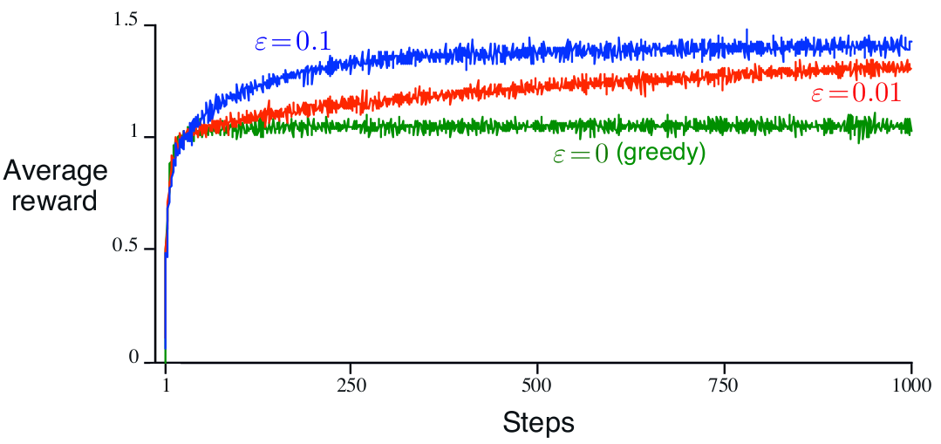
Average performance of 𝛆-greedy action-value methods on the 10-armed testbed
The graph shows the increase in expected reward with experience. The greedy method improved slightly faster than the other methods at the very beginning but then leveled off at a lower level. It achieved a reward-per-step of only about 1, compared with the best possible of about 1.55 on this testbed. The greedy method performed significantly worse in the long run because it often got stuck performing suboptimal actions

Slide 25
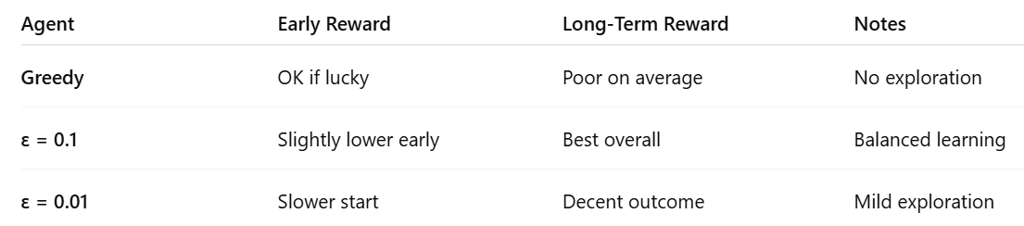
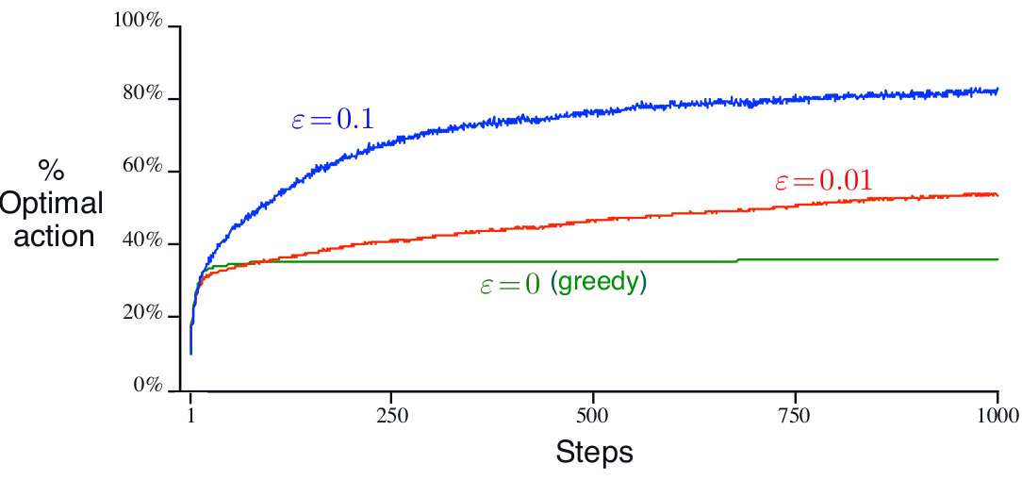
Average performance of 𝛆-greedy action-value methods on the 10-armed testbed

Slide 26
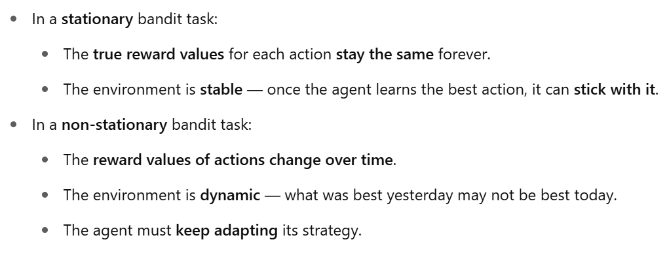
Discussion on Exploration vs. Exploitation
What if the reward variance is
larger, say 10 instead of 1?
zero ? [ deterministic ]
2) What if the bandit task is non-stationary? [ that is, the true values of the actions changed over time]
Non-stationary bandit = Changing environment

Slide 27
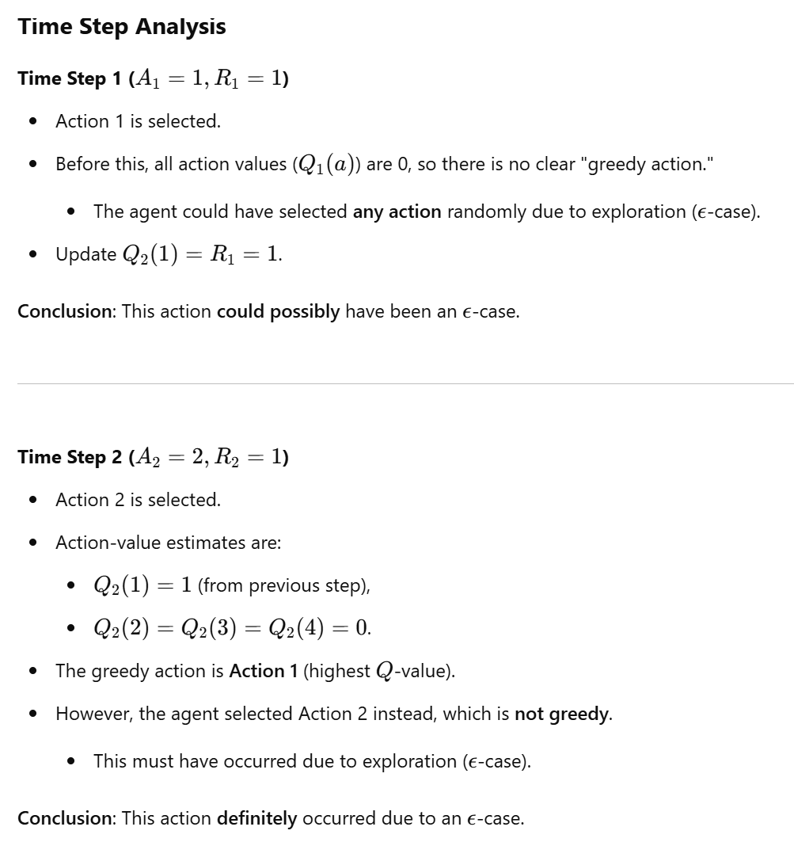
Ex-2:
Consider a k -armed bandit problem with k = 4 actions, denoted 1, 2, 3, and 4.
Consider applying to this problem a bandit algorithm using 𝛆-greedy action selection, sample-average action-value estimates, and initial estimates of Q1 (a) = 0, for all a.
Suppose the initial sequence of actions and rewards is A1 = 1, R1 = 1, A2 = 2, R2 = 1, A3 = 2, R3 = 2, A4 = 2, R4 = 2, A5 = 3, R5 = 0.
On some of these time steps the 𝛆 case may have occurred, causing an action to be selected at random.
On which time steps did this definitely occur? On which time steps could this possibly have occurred?

Slide 28
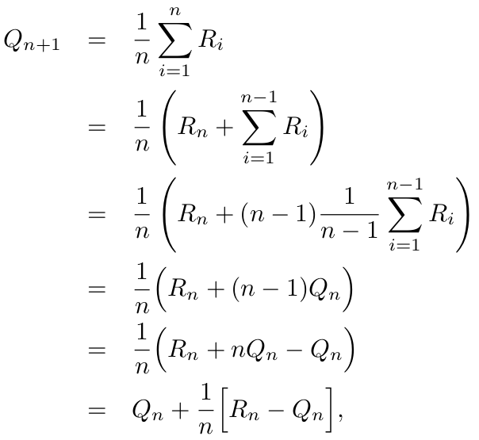
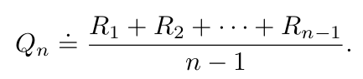
Incremental Implementation
Q_{n+1} = New estimate
Efficient approach to compute the estimate of action-value;
Given Qn and the nth reward, Rn , the new average of all n rewards can be computed as follows
Q_{n} = Old estimate (before the new reward R_{n}​)

Slide 29
Incremental Implementation
Note:
StepSize decreases with each update
We use 𝛂 or 𝛂_{t}(a) to denote step size (constant / varies with each step)
Discussion:
Const vs. Variable step size?

Slide 30
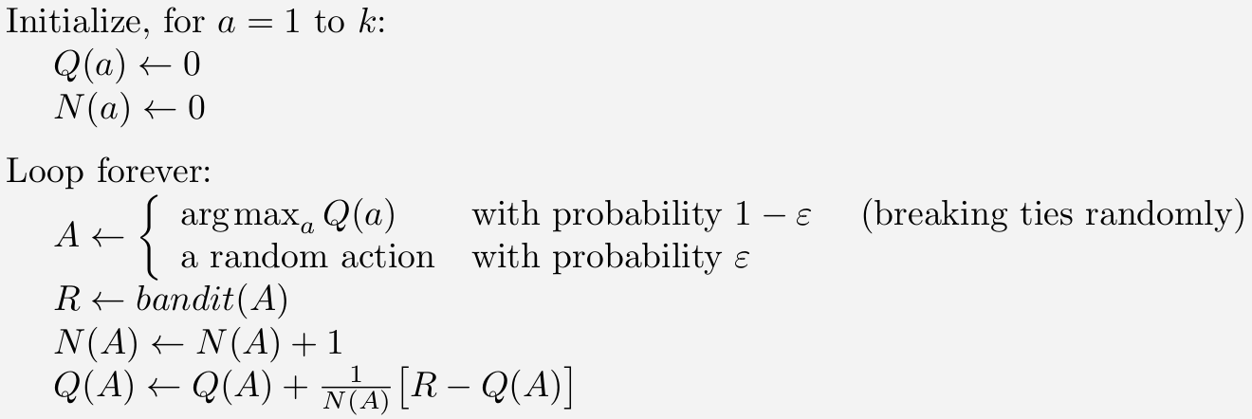
Bandit Algorithm with Incremental Update/ 𝛆-greedy selection

Slide 31
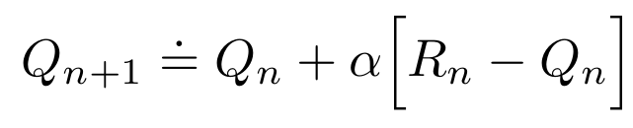
Non-stationary Problem
Most RL problems are non-stationary !
Give more weight to recent rewards than to long-past rewards !!!
The incremental update rule used in reinforcement learning for updating the estimated value of an action (Q) based on new observations.

Slide 32
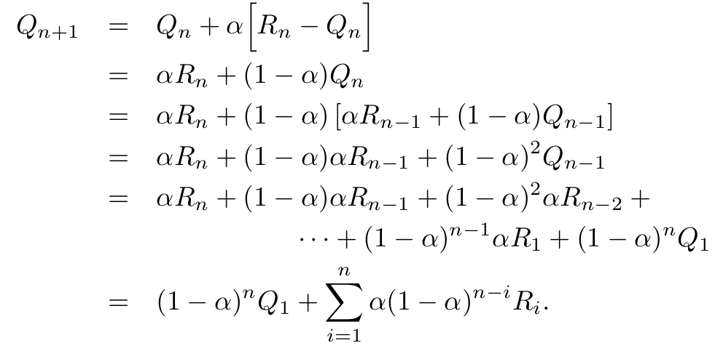
Non-stationary Problem
Most RL problems are non-stationary !
Give more weight to recent rewards than to long-past rewards !!!
Exponential recency-weighted average
Notes:
Averaging methods are appropriate for stationary bandit problems,
We often encounter reinforcement learning problems that are effectively nonstationary; In such cases it makes sense to give more weight to recent rewards than to long-past rewards.

Slide 33
Optimistic Initial Values
All the above discussed ﻿methods are biased by their initial estimates
For sample average method ﻿the bias disappears once all actions have been selected at least once
For methods with constant α, the bias is permanent, though decreasing over time
﻿Initial action values can also be used as a simple way of encouraging exploration.
In 10 armed testbed, set initial estimate to +5 rather than 0.
﻿This can encourage action-value methods to explore.
Whichever actions are initially selected, the reward is less than the starting estimates;
the learner switches to other actions, being disappointed with the rewards it is receiving.
The result is that all actions are tried several times before the value estimates converge.

Slide 34
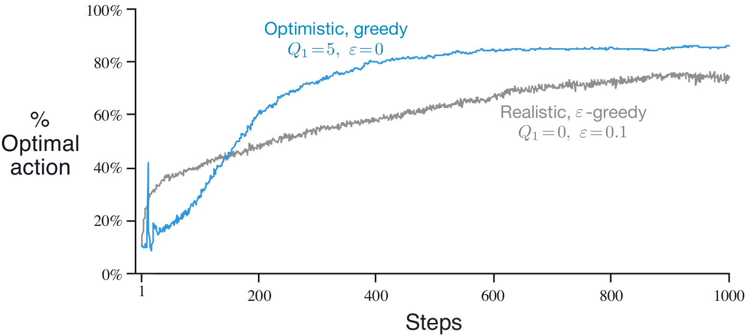
Optimistic Initial Values
Caution:
Optimistic Initial Values can only be considered as a simple trick that can be quite effective on stationary problems, but it is far from being a generally useful approach to encouraging exploration.
Question:
Explain how in the non-stationary scenario the optimistic initial values will fail (to explore adequately).
The effect of optimistic initial action-value estimates on the 10-armed testbed.
Both methods used a constant step-size parameter, 𝛂 = 0.1

Slide 35
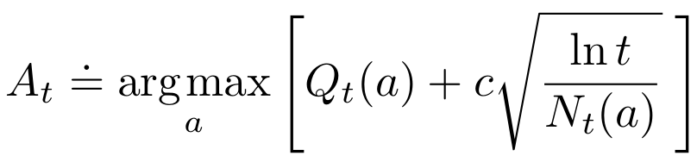
Upper-Confidence-Bound Action Selection
𝛆-greedy action selection forces the non-greedy actions to be tried,
Indiscriminately, with no preference for those that are nearly greedy or particularly uncertain
It would be better to select among the non-greedy actions according to their potential for actually being optimal
Take into account both how close their estimates are to being maximal and the uncertainties in those estimates.

Slide 36
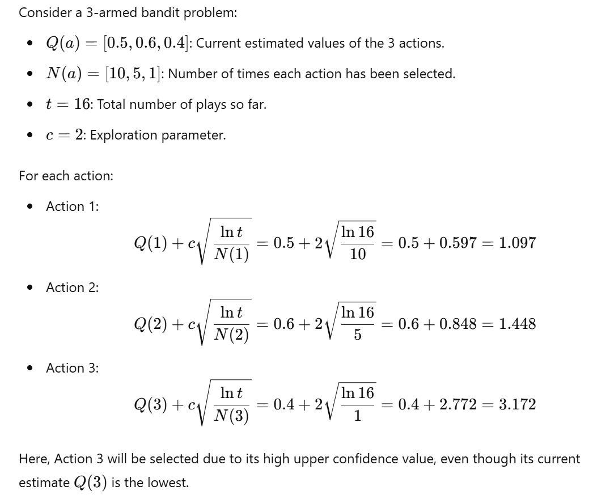
Upper-Confidence-Bound Action Selection
Each time a is selected the uncertainty is presumably reduced
Each time an action other than a is selected, t increases but N_{t}(a) does not; because t appears in the numerator, the uncertainty estimate increases.
Actions with lower value estimates, or that have already been selected frequently, will be selected with decreasing frequency over time
Confidence Level
Action Value at time t for a
Measure of Uncertainty
Notes:
c: exploration constant (controls exploration vs exploitation)
c: Larger values lead to more exploration

Slide 37
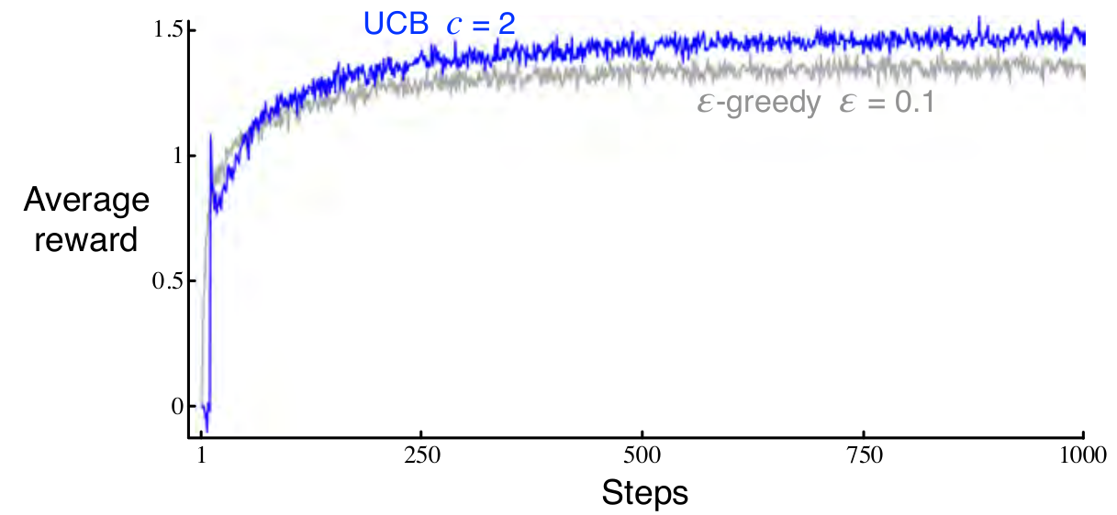
Upper-Confidence-Bound Action Selection
UCB often performs well, as shown here, but is more difficult than "-greedy to extend beyond bandits to the more general reinforcement learning settings

Slide 38
Required Readings
Chapter-2 of Introduction to Reinforcement Learning,2nd Ed., Sutton & Barto
A Survey on Practical Applications of Multi-Armed and Contextual Bandits, Djallel Bouneffouf , Irina Rish [https://arxiv.org/pdf/1904.10040.pdf]

Slide 39
Thank you !

